Slide 1
General Hardware Description
The Hydrosystem hardware is based on the raspberry pi3.
The user interface is based on web server. Wifi is mandatory for the system to work.
Hardware as the Clock, Temperature, humidity sensors etc. Are not mandatory but highly recommended to be implemented.
Relay are necessary to manage the actuators
All the project is designed to be cheap, save money as much as possible and still reach the target :)
The SW is open source hopefully everybody con contribute to it

Slide 2
Minimal hardware Setting
To test the hydrosystem you only require the raspberry pi3 (or the raspberry pi2 with correct wifi adapter)
In this hardware configuration you can have a look at the interface and evaluate if proceeding in adding more component
If you have a Usb webcam, then try to connect to the USB of RPI

Slide 3
Recommended hardware Setting
This hardware setting will use much of the system capabilities. This will allow to use Temperature and humidity sensor, keep the right time with Hardware clock in case the system is not connected to internet. Enable to use some actuators using a group of relays. With such relays you can switch on/off the watering valge, pumps, etc.

Slide 4
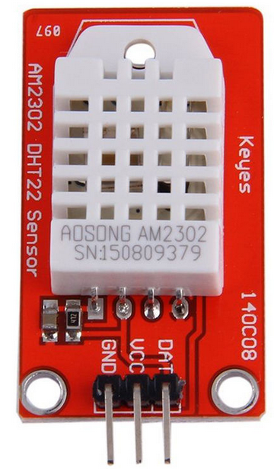
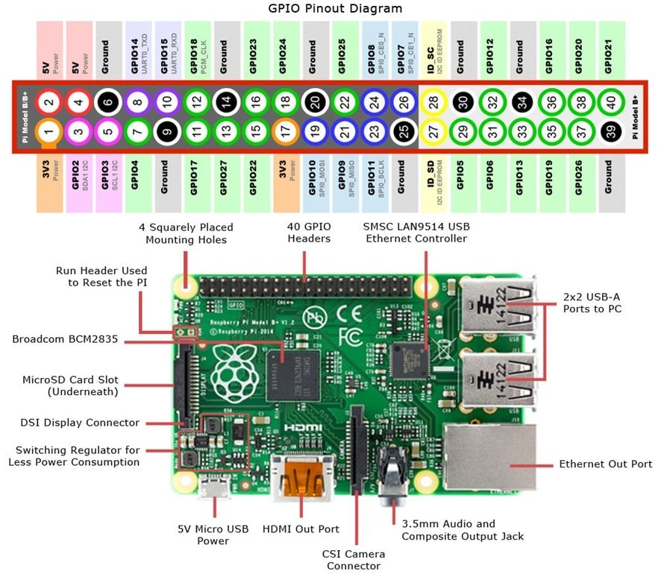
Connect the Humidity and temperature sensors
The Hydrosystem SW is designed to be compatible with the DHT22 sensor, this sensor is quite inexpensive and provides good accurancy for both temperature and Humidity. Below the connection schema:
Connect VCC to +3Vdc, th GND to ground and the DAT (or OUT) to the pin7. Pin7 is also numbered as GPIO04 or GCLK
The Sensor in the picture includes a couple of pull-up resistors required for the connection to the RPI. Current price in the market less than 5eur

Slide 5
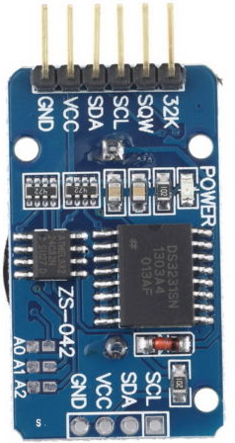
Connect the Hardware Clock
The Hardware clock is important if the RPI does not have a stable IP connection or the Hydrosystem works offline. It is highly recommended to add one of it to the project. The Real time Clock RTC based on the DS3231 chipset is inexpensive (less than 3 eur) and is sold together with battery.
Connect VCC to +5Vdc
GND to ground
SDA to pin3 also called GPIO02
SCL to pin5 also called GPIO03

Slide 6
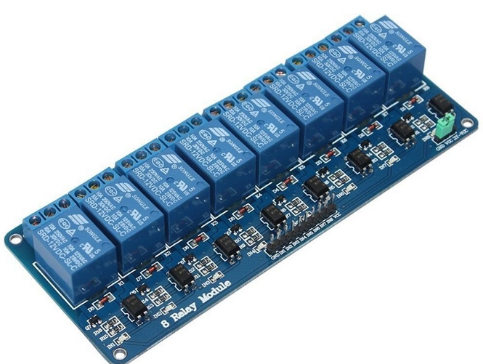
Connect Relays
Relays are used as switches for the actuator. The 5V relays in the market are compatible to be directly connected with RPI if they have the optocoupler, most of them have the optocoupler. The 8 relays board can be found for less than 10 eur. If 8 relays are not necessary, then also board of 4 or 2 relays are available.
The picture shows the 5v 8relays board.
Highlighted in the red circle the optocoupler
The relay logic is commonly negative, this means that they are activated when the input is low. This is not a problem for the SW as this parameter can be set

Slide 7
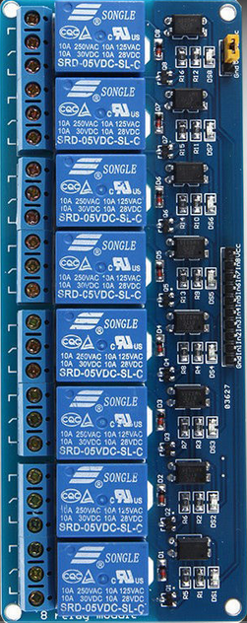
Connect the Relays board
The relays have 5v input. It is recommended for the actuators to use max 12V DC as security measure.
Connect VCC and GND which are normally located at the ends of the input line
It is recommended to use the following GPIO pins for the connection with relays input:
GPIO 5, 6, 13, 19, 26, 27, 20, 16

Slide 8
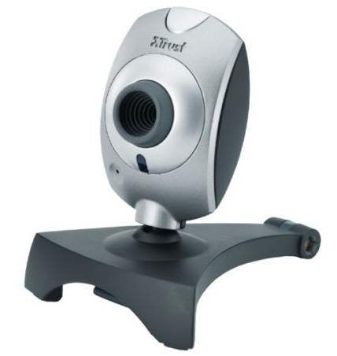
Connect webCam
The system is able to take some pictures, both with Rasicam of standard usb webcam, You can insert as much webcam as the USB available
NOTE: not all the USB webcam are compatible with raspberry even if most of the modern cameras are. On internet there is a list of compatible webcams for RPI, anyway only few are incompatible.

Slide 9
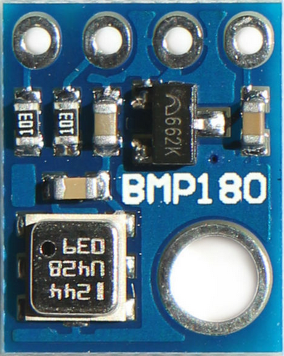
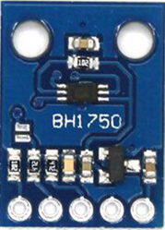
Atmospheric pressure and light sensors
If you are interested in monitoring the barometric pressure and the light intensity, it is possible to include two sensors that are already supported by the SW: the BH1750 for light and the BMP180 for the pressure. Both of them have the I2C interface and can be connected in parallel with other i2C devices. The below schema do not show the VCC and GND which should be connected to 5V supply.

Slide 10
Hydrosystem Power setting
One very important aspect of the project is the power supply. I found all required water valve and pumps working at 12vdc. For safety reason I choose the 12V for the actuators and 5vdc for raspberry, sensors and relay. Below the setup:
12V
5V
12V – 5A
power adapter
5V – 3A
DC-DC converter
Raspberry PI
Relay Input
3.3V
Relay Board
Sensors
Relay output
NOTE: The GPIO ground should be connected with the common ground. The power ground connection is not sufficient
Valve/Pumps

Slide 11
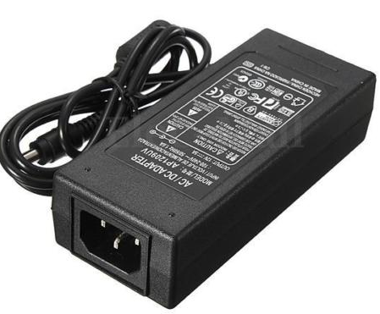

Hydrosystem Power items
Power is supplied to the system using a 12V-5a adapter and a 12V to 5V DC-DC converter 3A.
The adapter cost less than 10 eur
The DC-DC converter less than 5 eur
12V DC power supply 5A
12V DC to 5V DC converter
5V – 3A output

Slide 12
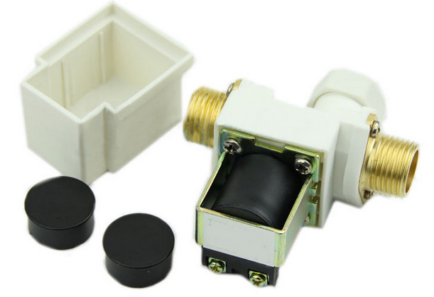
Electrovalve 12V
Below the 12v DC evectrovalve I have used in my setup. Cost no more than 10 eur each.
Found also the ¾ inch valve which is preferable due to the ¾ connection is more common in irrigation applications. Price around 6 eur each.

Slide 13
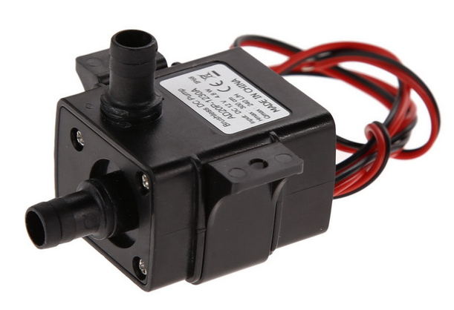
Automatic Fertilizer dosing
The automatic fertilized feeding is still under testing. I found that this mini pump at 12v are really useful for my implementation:
I still have problems with pipe and leakage, anyway this is the schema of automatic fertilization idea
12V Electro Valve
Valve
To the plants
Water supply pipe
One way valve
Fertilizer
Tank
Small sealed
tank
Mini
pump

Slide 14
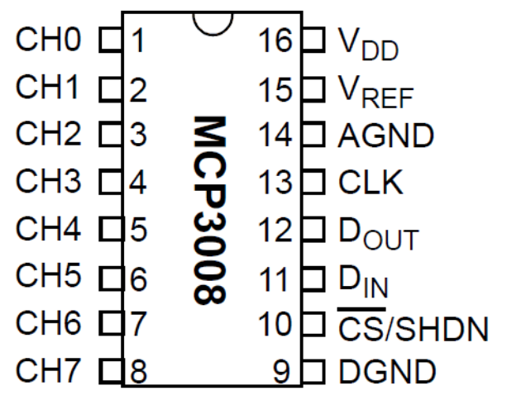
Hygrometer 1
The Hygrometer require the Analog digital converter MCP3008.
Vdd and Vref to +5Vdc
DGND and AGND to Ground
CLK to GPIO11 (23)
Dout to GPIO09 (21)
Din to GPIO10 (19)
CS to GPIO08 (24)

Slide 15
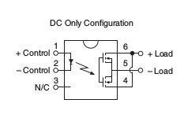
Hygrometer 2
The LCA110 is used to switch ON the current over the hygrometer plates, this to avoid keeping the plates under tension and reduce the corrosion.
PIN GPIO 12 or 25
vcc
LCA110
830 ohm
100 ohm
100 ohm
10K ohm
GND
GND

